Slide 1
Automatic Differentiation and Other Building Blocks of Deep Learning
Adam Celarek
Research Unit of Computer Graphics
Institute of Visual Computing & Human-Centered Technology
TU Wien, Austria

Slide 2
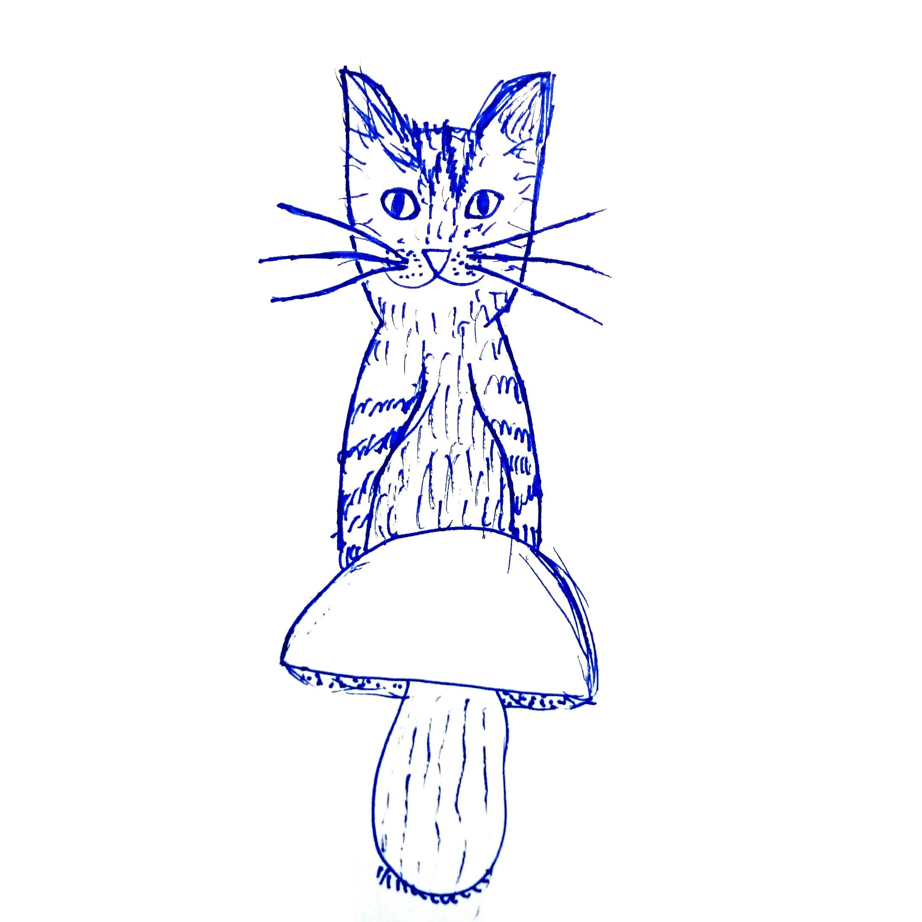
Overview
Deep Neural Networks (DNN)
  A Neuron and its activation function
  Layers
Learning
  Cost function, Gradient descent
  Automatic differentiation
Implementation / Demo

Slide 3
Deep Neural Networks
input
neural net
output
for simplicity just a vector
learning
target
also just vectors

Slide 4
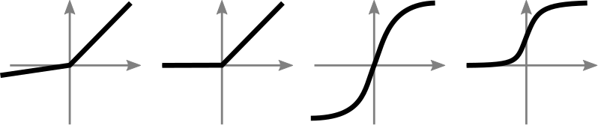
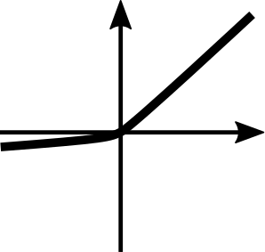

A Neuron and its activation function
bias
several options for transfer function
w0
transfer function
v0
v1
w1
v2
w2
w3
v3
...
wn
vn

Slide 5
Layers
layer 0
layer 1
layer 2
v0
v1
v2
v3
...
...
...
vn

Slide 6
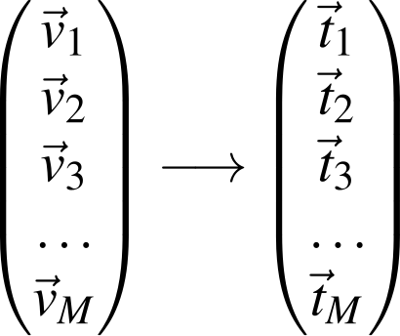
Learning / Cost function, Gradient descent
learn from examples
Change weights and biases in a way that the input is optimally mapped to the target
=> Minimise cost function using gradient descent.
input target

Slide 7
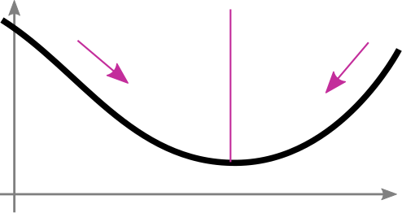
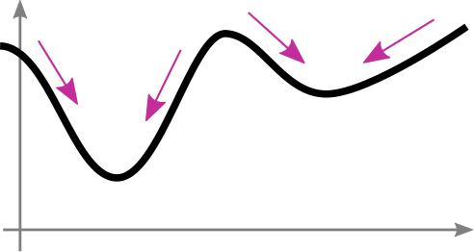
Learning / Gradient descent
compute gradient (derivative) of f(x) and go in opposite direction
xn+1 = xn - α * (d f(xn) / d xn)
df / dx < 0
df / dx > 0
f(x)
f(x)
local minimum
x
x

Slide 8
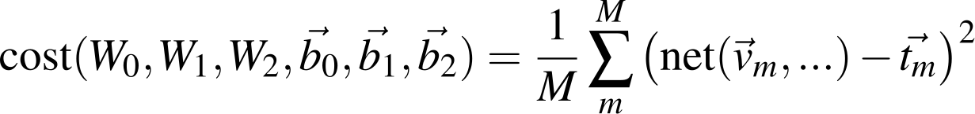


Learning / Cost function, Gradient descent
Minimise cost function using gradient descent.
more generally
we want to minimise that function => compute gradients for
and go into opposite direction => gradient descend

Slide 9
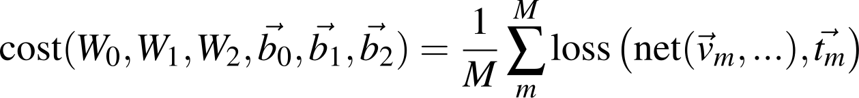
Learning / Cost function, Gradient descent
we want to compute the gradients / derivatives of a complicated function with many parameters (can be up to gigabytes of floats).
Differentiation methods:
symbolic
numeric
automatic

Slide 10
Automatic Differentiation / A complicated computation
f(x, y) = (x + y) * (y + 3)
x = 1, y = 2
f(x, y) = ?
df / dx = ?
df / dy = ?

Slide 11
Automatic Differentiation / A complicated computation
f(1, 2)
f(x, y) = (x + y) * (y + 3)
x = 1, y = 2
a = x + y
b = y + 3
f(x, y) = a * b
f(x, y) = ?
df / dx = ?
df / dy = ?
*
a
b
+
+
x = 1
y = 2
3

Slide 12
Automatic Differentiation / A complicated computation
f(1, 2) = 15
f(x, y) = (x + y) * (y + 3)
x = 1, y = 2
a = x + y
b = y + 3
f(x, y) = a * b
f(x, y) = 15
df / dx = ?
df / dy = ?
*
a = 3
b = 5
+
+
x = 1
y = 2
3

Slide 13
Automatic Differentiation / A complicated computation
f(1, 2) = 15 df / df = 1
f(x, y) = (x + y) * (y + 3)
x = 1, y = 2
a = x + y
b = y + 3
f(x, y) = a * b
f(x, y) = 15
df / dx = ?
df / dy = ?
*
a = 3
b = 5
df/db
df/da
+
+
da/dx
da/dy
db/dy
x = 1
y = 2
3

Slide 14
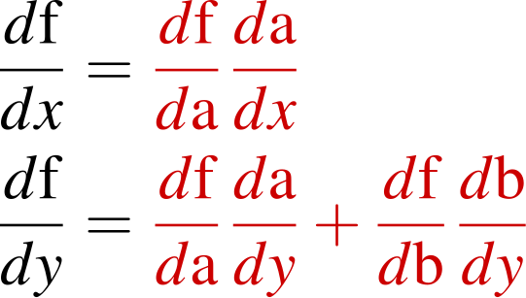
Automatic Differentiation / A complicated computation
f(1, 2) = 15 df / df = 1
f(x, y) = (x + y) * (y + 3)
x = 1, y = 2
a = x + y
b = y + 3
f(x, y) = a * b
f(x, y) = 15
*
a = 3
b = 5
df/db
df/da
+
+
da/dx
da/dy
db/dy
x = 1
y = 2
3

Slide 15
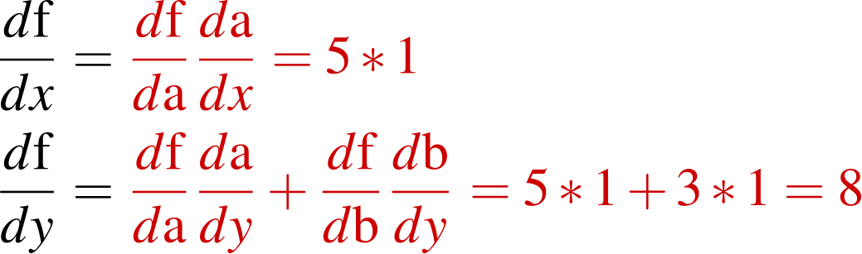
Automatic Differentiation / A complicated computation
f(1, 2) = 15 df / df = 1
f(x, y) = (x + y) * (y + 3)
x = 1, y = 2
a = x + y
b = y + 3
f(x, y) = a * b
f(x, y) = 15
*
a = 3
b = 5
df/db = a = 3
df/da = b = 5
+
+
da/dx = 1
da/dy=1
db/dy = 1
x = 1
y = 2
3

Slide 16

Automatic Differentiation / A complicated computation
f(x, y) = (x + y) * (y + 3)
x = 1, y = 2
a = x + y
b = y + 3
f(x, y) = a * b
f(x, y) = 15
check:
f(x,y) = xy + 3x + y^2 + 3y
df/dx = y + 3 = 5
df/dy = x + 2y + 3 = 1 + 4 + 3 = 8

Slide 17
AD / Why are we summing in the leaves
df / df = 1
f(yl, yr)
a
b
df/db
df/da
yl
yr
* da/dx
* da/dy
* db/dy
* db/dz
x
y
z

Slide 18
AD / A complicated implementation
Quick look at a 140 line python implementation

Slide 19

A full DNN implementation (C++ demo)
Longer look at the C++ DNN implementation

Slide 20
Problems during implementation
AD with matrices
In every node there is a gradient coming from the top. We need to compute the derivative wrt left and right, multiply and send it on.
per element operations
+
Matrix addition
Matrix multiplication, new dimensions
x
W
V

Slide 21
Problems during implementation
AD with matrices
easy
per element operations
W x V = O
(m*n) x (n*o) = (m*o)
+
Matrix addition
Matrix multiplication, new dimensions
x
gradient going to the left, right, coming from top
W
V

Slide 22
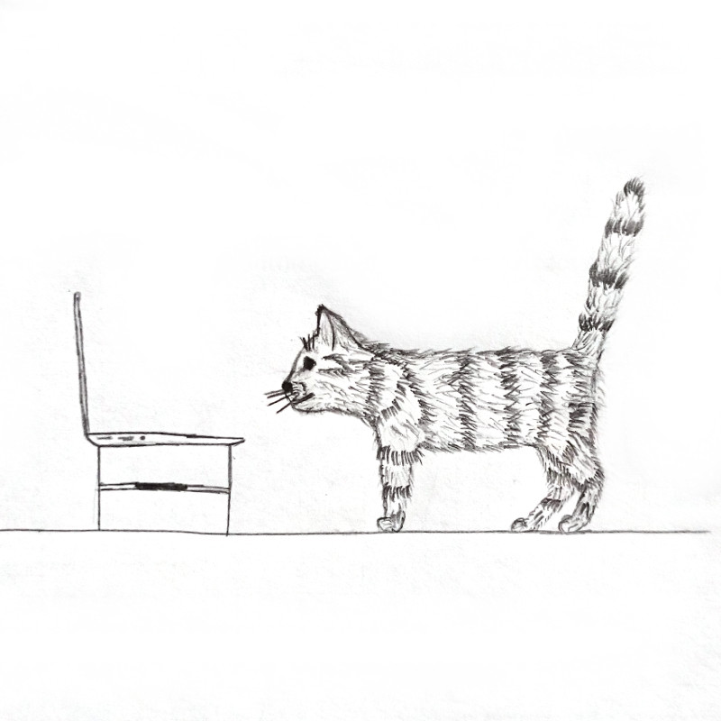
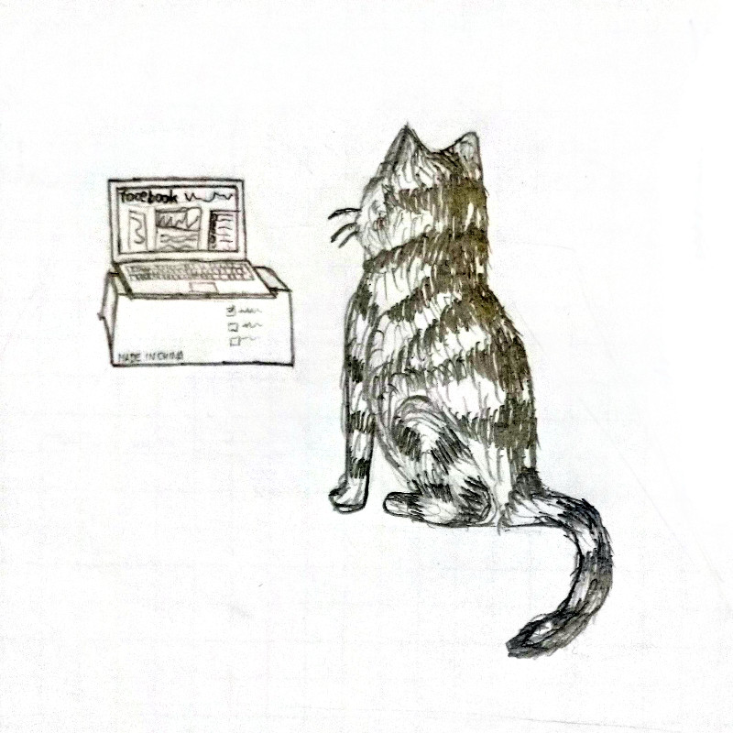
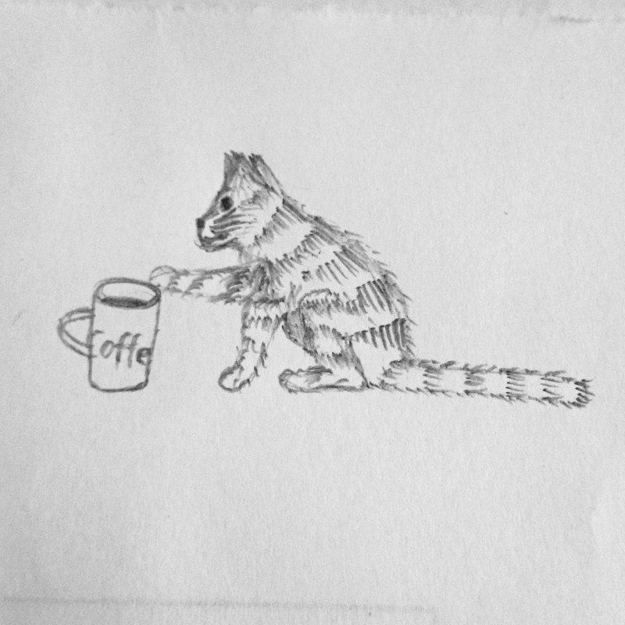

Problems during implementation
AD with matrices
A x B = C
(m*n) x (n*o) = (m*o)
Matrix multiplication, new dimensions
x
gradient going to the left, right, coming from top
A
B

Slide 23
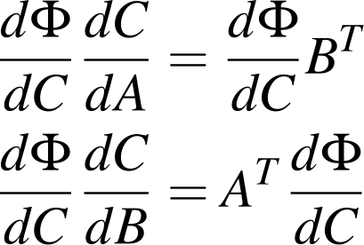
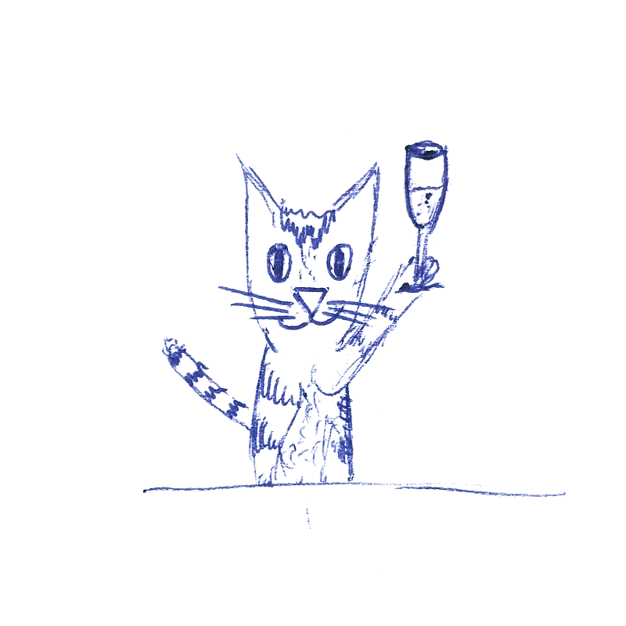
Problems during implementation
AD with matrices
C
A x B = C
(m*n) x (n*o) = (m*o)
Matrix multiplication, new dimensions
x
gradient going to the left, right, coming from top
A
B

Slide 24
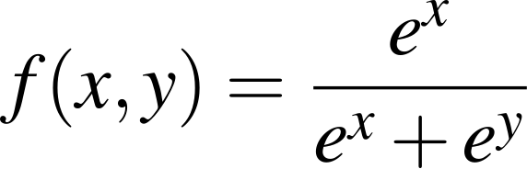
Problems during implementation
do you see what's wrong with that?

Slide 25
Problems during implementation
AD with matrices
Numerical stability
Vanishing gradients
Exploding gradients
Dying neurons
How to initialise the weights and biases

Slide 26
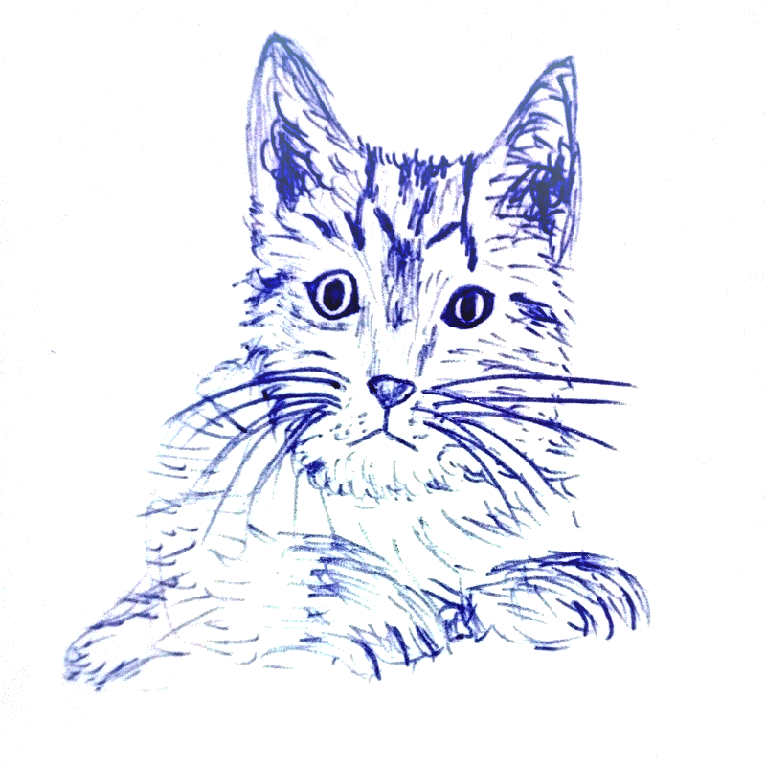
Summary and questions
DNNs are just a bunch of matrices and transfer
functions in the right order
They use gradient descent for learning, some-
thing a school kid could do
However, there are some challenges during implementation
github.com/cg-tuwien/deep_learning_demo
Questions?

